Slide 1
What Fuels GDP? A deeper look at petroleum
Project One
January 28th, 2020

Slide 2
Team Members
Jonpaul Mastropaolo
Tiger Cosmos
Tiania Chan
Joana Sean
Michael Maimoni

Slide 3
Table of Contents
Motivation & Summary
Questions & Data
Data Sources
Data Clean-up & Exploration
Data Analysis / Visualizations
Discussion
Post-mortem
Questions

Slide 4
Motivation & Summary (Simple)
Core Message
(Real) GDP is a measure of the economic health of a nation.
We hypothesized that there is a correlation between petroleum / transportation-related indicators and Real GDP, as well as among these indicators themselves.
Questions Asked
What is the relationship between our selected indicators set (below) and Real GDP in recent years (2007 to 2017)?
Annual Miles,
Average MPG,
Price of Petroleum, and
Consumption of Petroleum
What is the relationship between price and other indicators?
Are there other meaningful relationships between the other indicators?
Disclaimer: Our goal was not to reperform or debunk the publications of data scientists or economists but to go about finding out for ourselves the significance of petroleum-related factors as inputs to real GDP and to each other.
Notes:
-

Slide 5
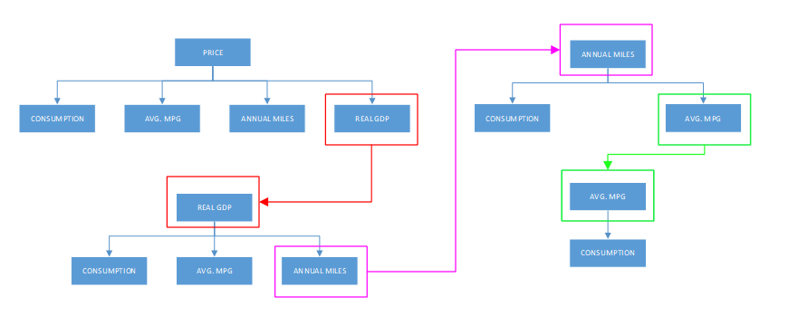
Questions and Data
5 Key Variables
Avg. Price of Petroleum
Real GDP
Annual Miles
Average Miles Per Gallon
Petroleum Consumption
Question
How are these key variables related to each other?
Is each variable significant in determining real GDP based upon the statistics obtained from the regression?
Based upon the p-values and correlation coefficients, is the linear regression a “good” predictive model?
Analyses
10 linear regressions conducted across the key variable set to determine the interrelationships of each key variable to other variables. See illustration.
Note: The time period of this data observed is from 2007 to 2017
Variable-to-Variable Relationships
Notes:
3 key questions

Slide 6


Data sources
Real GDP
Source: St. Louis Fed (FRED)
Website: https://fred.stlouisfed.org/series/GDPCA
Time Series: 2007 to 2017
Price and Consumption
Source: U. S. Energy Information Administration
Website: https://www.eia.gov/state/seds-data-complete.php?sid=US#CompleteDataFile
Time Series: 2007 to 2017
Average Miles Per Gallon (MPG)
Source: United States Department of Transportation
Website: https://www.bts.gov/content/average-fuel-efficiency-us-light-duty-vehicles
Time Series: 2007 to 2017
Annual Miles
Source: United States Department of Transportation
Website: https://www.bts.gov/content/us-vehicle-miles
Time Series: 2007 to 2017
Notes:
3 primary data sources as listed above
- FRED
- EIA
- BTS

Slide 7
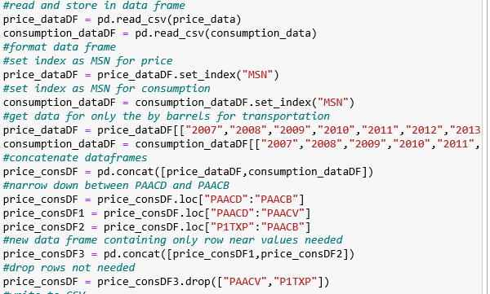
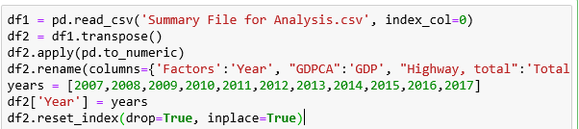
Data clean-up & exploration
Key Functions Used Include (but not limited to):
Import Functions
Data Frame Concatenations
Transposition (Column Headers)
Data Type Casting (To Numeric)
Punctuation Removal (Commas)
Index Reset
Note: No problems gaps or significant problems were discovered in the data clean up process.
Notes:
Insights on the data clean-up
- took a long time to convert to a integer / float; solution was to do a to_numeric()
- when transposing the data, a new index was created that was problematic to remove; later removed using del()

Slide 8
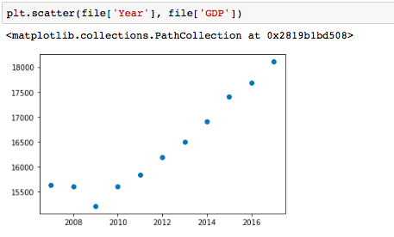
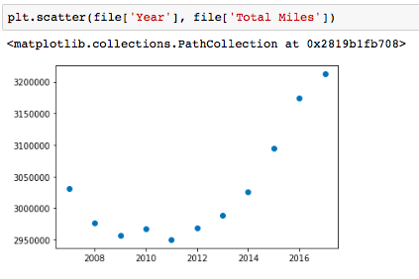
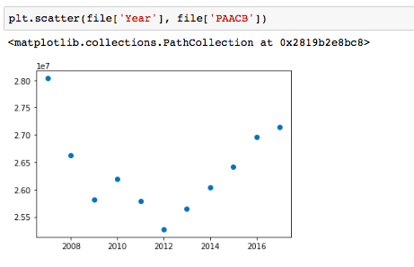
Data analysis: Visualizations
Economic Cycles Within Time Series Analyzed (2007 – 2017)
Periods of Downturn: 2008 – 2010
Periods of Expansion: 2007, 2011 - 2017
Scatterplot of Year (x-value) against Real GDP (y-value)
Scatterplot of Year (x-value) against Total Miles (y-value)
Scatterplot of Year (x-value) against Price of Petroleum
Notes:
Steps
- After obtaining a clean dataframe
→mathplotlib.pyplot() --> scatterplots of x and y using various pairs
→ Seaborn → full correlation across entire dataframe / confidence interval around linear regression plot

Slide 9
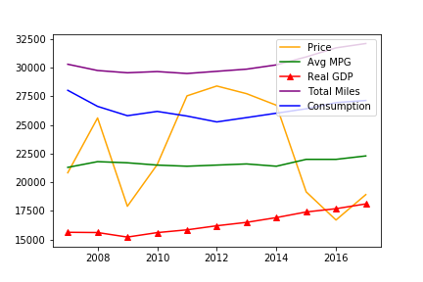
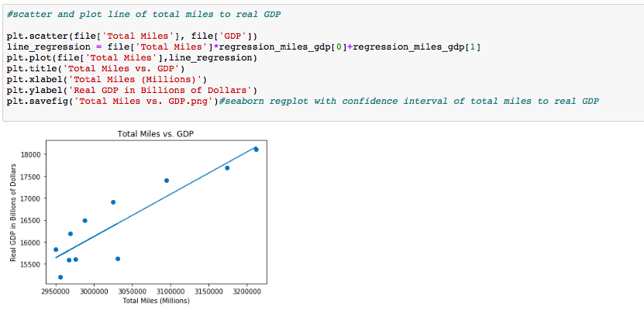
Data analysis: Visualizations (cont’D)
Overlaid line charts of Real GDP and other factors on a normalized scale (10,000s).
Scatterplot of Total Annual Miles (x-value) against Real GDP (y-value). A linear regression line (line of best fit) is overlaid on the scatter to model the relationship.
Note: The Seaborn Illustration for this regression on the following slide.
Notes:
Figure on the right. Scatter plot and linear regression model

Slide 10
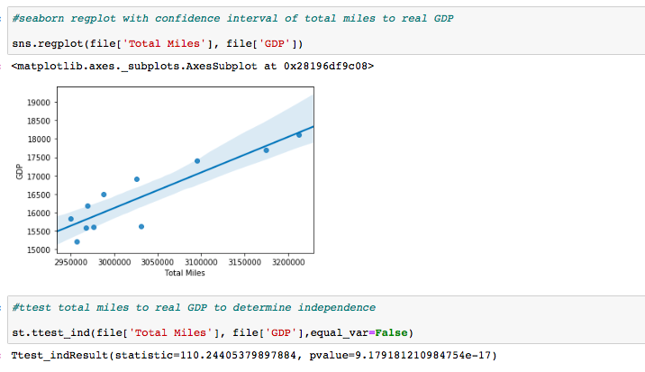
Data Visualizations: seaborn
About Seaborn:
Seaborn is a Python data visualization library based on matplotlib. It provides a high-level interface for drawing attractive and informative statistical graphics.
Code Implemented:
[1] import seaborn as sns
[2] sns.regplot(file[‘Total Miles’], file[‘GDP])
This is a Seaborn regression plot, or the regplot() function, showing a scatterplot, linear regression, and confidence interval for Total Miles to GDP.
Notes:
Seaborn regplot – plots linear regression as well as scatterplot for two lists; also displays confidence interval around the linear regression plot with shading.
Pretty cool.

Slide 11
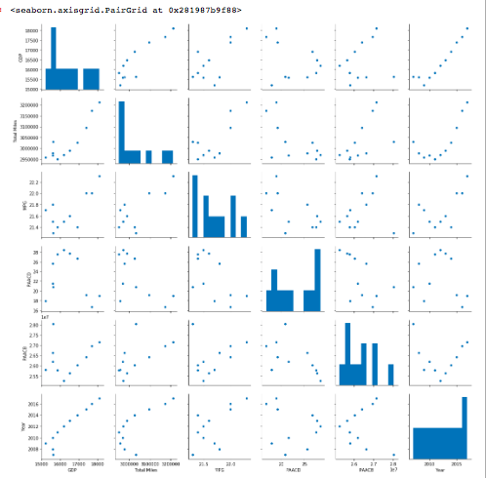
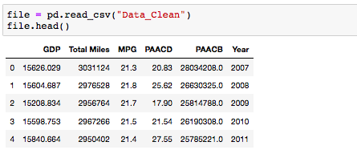
Data Visualizations: seaborn (cont’d)
[1] import seaborn as sns
[2] sns.pairplot(file)
##Diagonal Histogram, graphed for each variable-to-variable relationship.
Notes:
This is a combination of all pairs of factors and their scatterplots, as well as histograms
Based on the visual, we can see varying levels of correlation between the various factor pairs
Separately, we can see that our data does not appear to be normally distributed – likely would improve with a larger dataset, but…hit us with the funding (round b)

Slide 12
discussion
Analysis Set | Factor Pair (Simple) | Correlation Coefficients | Hypothesized Relationship | Observed Relationship
Price vs. Other Factors | Price / Consumption | -0.57305 * | ▼ | ▼
 | Price / Average MPG | -0.58738 * | ▲ | ▼
 | Price / Annual Miles | 0.61704 * | ▼ | ▲
Factors vs. Real GDP | Price / Real GDP | -0.30844 | ▼ | ▼
 | Consumption / Real GDP | 0.22695 | ▲ | ▲
 | Average MPG / Real GDP | 0.70717 * | ? ? ? | ▲
 | Annual Miles / Real GDP | 0.89660 * | ▲ | ▲
Other | Consumption / Annual Miles | 0.57517 * | ▲ | ▲
 | Average MPG / Consumption | 0.24919 | ? ? ? | ▲
 | Average MPG / Annual Miles | 0.77933 * | ▲ | ▲
* = Correlation Coefficient > 0.50 (abs)
Notes:
Price / Annual Miles – interesting insight into what might cause this situation to occur, probably external economic factors. We need to take into account the period over which it was happening.
Price / Average MPG – I don’t know how these would have any correlation. What was the p-value for this? P-value is .41. Additionally, average MPG has other influences (regulation).
??? – no relationship anticipated – Avg MPG / Real GDP – low p-value and high correlation coefficient –inconclusive without a larger dataset. So although the cc is strong, we don’t have enough information to conclude.
Average MPG / Consumption - ??? -

Slide 13

Post mortem
If you had two more weeks to do this project, what would be the next challenge?
Ordinary Least Squares Regression for the top factors uncovered within our preliminary analysis to further understand the impact these factors jointly have on GDP.
Increase the time series to another decade or two to have a more comprehensive look.
Disaggregation of data points.
Notes:
Were there any difficulties that arose during your analysis? If yes, then how did you deal with them?
Did any additional questions come up in your analysis?

Slide 14
Questions
Open discussion to Q&A from the class.

Slide 15
end

Slide 16
Appendix A - Questions
Relationship between price and other data points
What is the relationship between price and consumption?
What is the relationship between price and average MPG?
What is the relationship between price and annual miles?
What is the relationship between price and real GDP?
Relationships between factors and GDP
What is the relationship between consumption and real GDP?
What is the relationship between average MPG and real GDP?
What is the relationship between annual miles and real GDP?
Other questions
What is the relationship between consumption and annual miles?
What is the relationship between average MPG and consumption?
What is the relationship between average MPG and annual miles?

Slide 17
Appendix B - Summary of Findings
Analysis Set | Factor Pair (Simple) | Correlation Coefficients | Hypothesized Relationship | Observed Relationship
Price vs. Other Factors | Price / Consumption | -0.57305 * | ▼ | ▼
 | Price / Average MPG | -0.58738 * | ▲ | ▼
 | Price / Annual Miles | 0.61704 * | ▼ | ▲
Factors vs. Real GDP | Price / Real GDP | -0.30844 | ▼ | ▼
 | Consumption / Real GDP | 0.22695 | ▲ | ▲
 | Average MPG / Real GDP | 0.70717 * | ? ? ? | ▲
 | Annual Miles / Real GDP | 0.89660 * | ▲ | ▲
Other | Consumption / Annual Miles | 0.57517 * | ▲ | ▲
 | Average MPG / Consumption | 0.24919 | ? ? ? | ▲
 | Average MPG / Annual Miles | 0.77933 * | ▲ | ▲
* = Correlation Coefficient > 0.50 (abs)

Slide 18
Motivation & Summary (Expanded)
Core Message
Gross Domestic Product, or GDP, is a number that is determined by economists to be the defining number of economic health for a nation in any given quarter or year. This number includes a variety of calculations and input factors that are equally hard to decipher.
Our team decided to break apart several of the input factors of interest and discern for ourselves which factors are stronger and which weaker as determinant of real GDP. The focus was around petroleum-related products and consumption.
Disclaimer: Our goal was not to reperform or debunk the publications of data scientists or economists but to go about finding out for ourselves the significance of petroleum-related factors as inputs to real GDP and to each other.
Questions Asked
Our team focused the analysis on the strength of the relationships between each of the key variables, and ultimately on the relationships of these key variables (inputs) as determinants of real GDP (output). This was done as a time series, from 2007 to 2017, on the following factors: Real GDP, Annual Miles, Average MPG, Price of Petroleum, and Consumption of Petroleum.
Note: See the following slide for illustration of key variables and relationships analyzed.
Upon completion of all 10 linear regressions, our team was able to answer our questions based upon the p-value and correlation coefficients obtained from each regression completed.

